Slide 1
CS162 Operating Systems and Systems Programming Lecture 9 Synchronization (cont’d), Readers/Writers example
September 24th, 2018
Prof. Ion Stoica
http://cs162.eecs.Berkeley.edu

Slide 2
Motivation for Monitors and Condition Variables
Semaphores are a huge step up; just think of trying to do the bounded buffer with only loads and stores
Problem is that semaphores are dual purpose:
They are used for both mutex and scheduling constraints
Example: the fact that flipping of P’s in bounded buffer gives deadlock is not immediately obvious. How do you prove correctness to someone?
Cleaner idea: Use locks for mutual exclusion and condition variables for scheduling constraints
Definition: Monitor, a lock and zero or more condition variables for managing concurrent access to shared data
Some languages like Java provide this natively
Most others use actual locks and condition variables

Slide 3
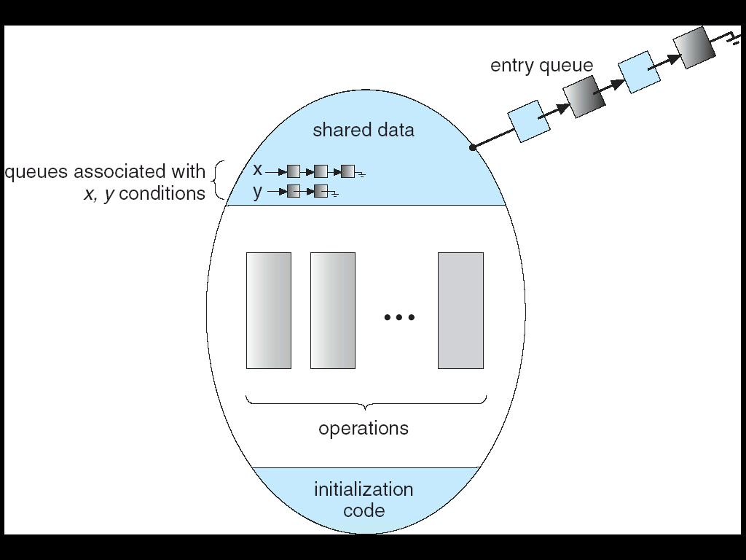
Monitor with Condition Variables
Lock: the lock provides mutual exclusion to shared data
Always acquire before accessing shared data structure
Always release after finishing with shared data
Lock initially free
Condition Variable: a queue of threads waiting for something inside a critical section
Key idea: make it possible to go to sleep inside critical section by atomically releasing lock at time we go to sleep
Contrast to semaphores: Can’t wait inside critical section

Slide 4
Simple Monitor Example (version 1)
Here is an (infinite) synchronized queue
Lock lock; Queue queue;
AddToQueue(item) { lock.Acquire(); // Lock shared data queue.enqueue(item); // Add item lock.Release(); // Release Lock }
RemoveFromQueue() { lock.Acquire(); // Lock shared data item = queue.dequeue();// Get next item or null lock.Release(); // Release Lock return(item); // Might return null }
Not very interesting use of “Monitor”
It only uses a lock with no condition variables
Cannot put consumer to sleep if no work!

Slide 5
Condition Variables
How do we change the RemoveFromQueue() routine to wait until something is on the queue?
Could do this by keeping a count of the number of things on the queue (with semaphores), but error prone
Condition Variable: a queue of threads waiting for something inside a critical section
Key idea: allow sleeping inside critical section by atomically releasing lock at time we go to sleep
Contrast to semaphores: Can’t wait inside critical section
Operations:
Wait(&lock): Atomically release lock and go to sleep. Re-acquire lock later, before returning.
Signal(): Wake up one waiter, if any
Broadcast(): Wake up all waiters
Rule: Must hold lock when doing condition variable ops!
In Birrell paper, he says can perform signal() outside of lock – IGNORE HIM (this is only an optimization)

Slide 6
Complete Monitor Example (with cond. variable)
Here is an (infinite) synchronized queue
Lock lock; Condition dataready; Queue queue;
AddToQueue(item) { lock.Acquire(); // Get Lock queue.enqueue(item); // Add item dataready.signal(); // Signal any waiters lock.Release(); // Release Lock }
RemoveFromQueue() { lock.Acquire(); // Get Lock while (queue.isEmpty()) { dataready.wait(&lock); // If nothing, sleep } item = queue.dequeue(); // Get next item lock.Release(); // Release Lock return(item); }

Slide 7
Mesa vs. Hoare monitors
Need to be careful about precise definition of signal and wait. Consider a piece of our dequeue code:
while (queue.isEmpty()) { dataready.wait(&lock); // If nothing, sleep } item = queue.dequeue(); // Get next item
Why didn’t we do this?
if (queue.isEmpty()) { dataready.wait(&lock); // If nothing, sleep } item = queue.dequeue(); // Get next item
Answer: depends on the type of scheduling
Hoare-style
Mesa-style

Slide 8
Hoare monitors
Signaler gives up lock, CPU to waiter; waiter runs immediately
Waiter gives up lock, processor back to signaler when it exits critical section or if it waits again
Most textbooks
…
lock.Acquire()
…
dataready.signal();
…
lock.Release();
lock.Acquire()
…
if (queue.isEmpty()) { dataready.wait(&lock); } …
lock.Release();
Lock, CPU
Lock, CPU

Slide 9
Mesa monitors
Signaler keeps lock and processor
Waiter placed on ready queue with no special priority
Practically, need to check condition again after wait
Most real operating systems
Put waiting thread on ready queue
…
lock.Acquire()
…
dataready.signal();
…
lock.Release();
lock.Acquire()
…
while (queue.isEmpty()) { dataready.wait(&lock); } …
lock.Release();
schedule waiting thread

Slide 10
Mesa Monitor: Why “while()”?
Why do we use “while()” instead of “if() with Mesa monitors?
Example illustrating what happens if we use “if()”, e.g.,
if (queue.isEmpty()) { dataready.wait(&lock); // If nothing, sleep }
We’ll use the synchronized (infinite) queue example
AddToQueue(item) {
lock.Acquire(); queue.enqueue(item); dataready.signal(); lock.Release();
}
RemoveFromQueue() { lock.Acquire(); if (queue.isEmpty()) { dataready.wait(&lock); } item = queue.dequeue(); lock.Release(); return(item);
}
Replace “while” with “if”

Slide 11
Mesa Monitor: Why “while()”?
App. Shared State
Monitor
CPU State
queue
lock: FREE
Running: T1
Ready
queue → NULL
…
dataready
queue
NULL
T1 (Running)
RemoveFromQueue() { lock.Acquire(); if (queue.isEmpty()) {
dataready.wait(&lock);
} item = queue.dequeue(); lock.Release();
return(item);
}

Slide 12
Mesa Monitor: Why “while()”?
App. Shared State
Monitor
CPU State
queue
lock: BUSY (T1)
Running: T1
Ready
queue → NULL
…
dataready
queue
NULL
T1 (Running)
RemoveFromQueue() { lock.Acquire(); if (queue.isEmpty()) {
dataready.wait(&lock);
} item = queue.dequeue(); lock.Release();
return(item);
}

Slide 13
Mesa Monitor: Why “while()”?
App. Shared State
Monitor
CPU State
queue
lock: FREE
Running:
Ready
queue → NULL
…
dataready
queue
T1
wait(&lock) puts thread on dataready queue and releases lock
T1 (Waiting)
RemoveFromQueue() { lock.Acquire(); if (queue.isEmpty()) {
dataready.wait(&lock);
} item = queue.dequeue(); lock.Release();
return(item);
}

Slide 14
Mesa Monitor: Why “while()”?
App. Shared State
Monitor
CPU State
queue
lock: FREE
Running: T2
Ready
queue → NULL
…
dataready
queue
T1
T1 (Waiting)
T2 (Running)
RemoveFromQueue() { lock.Acquire(); if (queue.isEmpty()) {
dataready.wait(&lock);
} item = queue.dequeue(); lock.Release();
return(item);
}
AddToQueue(item) { lock.Acquire();
queue.enqueue(item); dataready.signal(); lock.Release(); }

Slide 15
Mesa Monitor: Why “while()”?
App. Shared State
Monitor
CPU State
queue
add
item
lock: BUSY (T2)
Running: T2
Ready
queue → NULL
…
dataready
queue
T1
T1 (Waiting)
T2 (Running)
RemoveFromQueue() { lock.Acquire(); if (queue.isEmpty()) {
dataready.wait(&lock);
} item = queue.dequeue(); lock.Release();
return(item);
}
AddToQueue(item) { lock.Acquire();
queue.enqueue(item); dataready.signal(); lock.Release(); }

Slide 16
Mesa Monitor: Why “while()”?
App. Shared State
Monitor
CPU State
queue
lock: BUSY (T2)
Running: T2
Ready
queue → T1
…
dataready
queue
NULL
T1 (Ready)
T2 (Running)
signal() wakes up T1 and moves it on ready queue
RemoveFromQueue() { lock.Acquire(); if (queue.isEmpty()) {
dataready.wait(&lock);
} item = queue.dequeue(); lock.Release();
return(item);
}
AddToQueue(item) { lock.Acquire();
queue.enqueue(item); dataready.signal(); lock.Release(); }

Slide 17
Mesa Monitor: Why “while()”?
App. Shared State
Monitor
CPU State
queue
lock: BUSY (T2)
Running: T2
Ready
queue → T1, T3
…
dataready
queue
NULL
T1 (Ready)
T2 (Running)
T3 (Ready)
RemoveFromQueue() { lock.Acquire(); if (queue.isEmpty()) {
dataready.wait(&lock);
} item = queue.dequeue(); lock.Release();
return(item);
}
AddToQueue(item) { lock.Acquire();
queue.enqueue(item); dataready.signal(); lock.Release(); }
RemoveFromQueue() { lock.Acquire(); if (queue.isEmpty()) {
dataready.wait(&lock);
} item = queue.dequeue(); lock.Release();
return(item);
}

Slide 18
Mesa Monitor: Why “while()”?
App. Shared State
Monitor
CPU State
queue
lock: FREE
Running:
Ready
queue → T1, T3
…
dataready
queue
NULL
T1 (Ready)
T2 (Terminate)
T3 (Ready)
RemoveFromQueue() { lock.Acquire(); if (queue.isEmpty()) {
dataready.wait(&lock);
} item = queue.dequeue(); lock.Release();
return(item);
}
AddToQueue(item) { lock.Acquire();
queue.enqueue(item); dataready.signal(); lock.Release(); }
RemoveFromQueue() { lock.Acquire(); if (queue.isEmpty()) {
dataready.wait(&lock);
} item = queue.dequeue(); lock.Release();
return(item);
}

Slide 19
Mesa Monitor: Why “while()”?
App. Shared State
Monitor
CPU State
queue
lock: FREE
Running: T3
Ready
queue → T1
…
dataready
queue
NULL
T3 scheduled first!
T1 (Ready)
T3 (Running)
RemoveFromQueue() { lock.Acquire(); if (queue.isEmpty()) {
dataready.wait(&lock);
} item = queue.dequeue(); lock.Release();
return(item);
}
RemoveFromQueue() { lock.Acquire(); if (queue.isEmpty()) {
dataready.wait(&lock);
} item = queue.dequeue(); lock.Release();
return(item);
}

Slide 20
Mesa Monitor: Why “while()”?
App. Shared State
Monitor
CPU State
queue
lock: BUSY (T3)
Running: T3
Ready
queue → T1
…
dataready
queue
NULL
T1 (Ready)
T3 (Running)
RemoveFromQueue() { lock.Acquire(); if (queue.isEmpty()) {
dataready.wait(&lock);
} item = queue.dequeue(); lock.Release();
return(item);
}
RemoveFromQueue() { lock.Acquire(); if (queue.isEmpty()) {
dataready.wait(&lock);
} item = queue.dequeue(); lock.Release();
return(item);
}

Slide 21
Mesa Monitor: Why “while()”?
App. Shared State
Monitor
CPU State
queue
remove
item
lock: BUSY (T3)
Running: T3
Ready
queue → T1
…
dataready
queue
NULL
T1 (Ready)
T3 (Running)
RemoveFromQueue() { lock.Acquire(); if (queue.isEmpty()) {
dataready.wait(&lock);
} item = queue.dequeue(); lock.Release();
return(item);
}
RemoveFromQueue() { lock.Acquire(); if (queue.isEmpty()) {
dataready.wait(&lock);
} item = queue.dequeue(); lock.Release();
return(item);
}

Slide 22
Mesa Monitor: Why “while()”?
App. Shared State
Monitor
CPU State
queue
lock: FREE
Running:
Ready
queue → T1
…
dataready
queue
NULL
T1 (Ready)
T3 (Finished)
RemoveFromQueue() { lock.Acquire(); if (queue.isEmpty()) {
dataready.wait(&lock);
} item = queue.dequeue(); lock.Release();
return(item);
}
RemoveFromQueue() { lock.Acquire(); if (queue.isEmpty()) {
dataready.wait(&lock);
} item = queue.dequeue(); lock.Release();
return(item);
}

Slide 23
Mesa Monitor: Why “while()”?
App. Shared State
Monitor
CPU State
queue
lock: BUSY (T1)
Running: T1
Ready
queue → NULL
…
dataready
queue
NULL
T1 (Running)
RemoveFromQueue() { lock.Acquire(); if (queue.isEmpty()) {
dataready.wait(&lock);
} item = queue.dequeue(); lock.Release();
return(item);
}

Slide 24
Mesa Monitor: Why “while()”?
App. Shared State
Monitor
CPU State
queue
lock: BUSY (T1)
Running: T1
Ready
queue → NULL
…
dataready
queue
NULL
T1 (Running)
RemoveFromQueue() { lock.Acquire(); if (queue.isEmpty()) {
dataready.wait(&lock);
} item = queue.dequeue(); lock.Release();
return(item);
}
ERROR: Nothing in the queue!

Slide 25
Mesa Monitor: Why “while()”?
App. Shared State
Monitor
CPU State
queue
lock: BUSY (T1)
Running: T1
Ready
queue → NULL
…
dataready
queue
NULL
T1 (Running)
RemoveFromQueue() { lock.Acquire(); while (queue.isEmpty()) {
dataready.wait(&lock);
} item = queue.dequeue(); lock.Release();
return(item);
}
Replace “if” with “while”

Slide 26
Mesa Monitor: Why “while()”?
App. Shared State
Monitor
CPU State
queue
lock: BUSY (T1)
Running: T1
Ready
queue → NULL
…
dataready
queue
NULL
T1 (Ready)
RemoveFromQueue() { lock.Acquire(); while (queue.isEmpty()) {
dataready.wait(&lock);
} item = queue.dequeue(); lock.Release();
return(item);
}
Check again if empty!

Slide 27
Mesa Monitor: Why “while()”?
App. Shared State
Monitor
CPU State
queue
lock: FREE
Running: T1
Ready
queue → NULL
…
dataready
queue
T1
T1 (Waiting)
RemoveFromQueue() { lock.Acquire(); while (queue.isEmpty()) {
dataready.wait(&lock);
} item = queue.dequeue(); lock.Release();
return(item);
}

Slide 28
Administrivia
Midterm on Monday 10/1 5:00-6:30PM
Closed book, no calculators, one double-side letter-sized page of handwritten notes

Slide 29
BREAK

Slide 30
Readers/Writers Problem
W
R
R
R
Motivation: Consider a shared database
Two classes of users:
Readers – never modify database
Writers – read and modify database
Is using a single lock on the whole database sufficient?
Like to have many readers at the same time
Only one writer at a time

Slide 31
Basic Readers/Writers Solution
Correctness Constraints:
Readers can access database when no writers
Writers can access database when no readers or writers
Only one thread manipulates state variables at a time
Basic structure of a solution:
Reader() Wait until no writers Access data base Check out – wake up a waiting writer
Writer() Wait until no active readers or writers Access database Check out – wake up waiting readers or writer
State variables (Protected by a lock called “lock”):
int AR: Number of active readers; initially = 0
int WR: Number of waiting readers; initially = 0
int AW: Number of active writers; initially = 0
int WW: Number of waiting writers; initially = 0
Condition okToRead = NIL
Condition okToWrite = NIL

Slide 32
Code for a Reader
Reader() { // First check self into system lock.Acquire();
while ((AW + WW) > 0) { // Is it safe to read? WR++; // No. Writers exist okToRead.wait(&lock); // Sleep on cond var WR--; // No longer waiting }
AR++; // Now we are active! lock.release();
// Perform actual read-only access AccessDatabase(ReadOnly);
// Now, check out of system lock.Acquire(); AR--; // No longer active if (AR == 0 && WW > 0) // No other active readers okToWrite.signal(); // Wake up one writer lock.Release(); }
Why release lock here?

Slide 33
Code for a Writer
Writer() { // First check self into system lock.Acquire();
while ((AW + AR) > 0) { // Is it safe to write? WW++; // No. Active users exist okToWrite.wait(&lock); // Sleep on cond var WW--; // No longer waiting }
AW++; // Now we are active! lock.release();
// Perform actual read/write access AccessDatabase(ReadWrite);
// Now, check out of system lock.Acquire(); AW--; // No longer active if (WW > 0){ // Give priority to writers okToWrite.signal(); // Wake up one writer } else if (WR > 0) { // Otherwise, wake reader okToRead.broadcast(); // Wake all readers } lock.Release(); }
Why Give priority to writers?
Why broadcast() here instead of signal()?

Slide 34
Simulation of Readers/Writers Solution
Use an example to simulate the solution
Consider the following sequence of operators:
R1, R2, W1, R3
Initially: AR = 0, WR = 0, AW = 0, WW = 0

Slide 35
Simulation of Readers/Writers Solution
R1 comes along
AR = 0, WR = 0, AW = 0, WW = 0
Reader() { lock.Acquire();
while ((AW + WW) > 0) { // Is it safe to read? WR++; // No. Writers exist okToRead.wait(&lock); // Sleep on cond var WR--; // No longer waiting }
AR++; // Now we are active! lock.release();
AccessDbase(ReadOnly);
lock.Acquire(); AR--; if (AR == 0 && WW > 0) okToWrite.signal(); lock.Release(); }

Slide 36
Simulation of Readers/Writers Solution
R1 comes along
AR = 0, WR = 0, AW = 0, WW = 0
Reader() { lock.Acquire();
while ((AW + WW) > 0) { // Is it safe to read? WR++; // No. Writers exist okToRead.wait(&lock); // Sleep on cond var WR--; // No longer waiting }
AR++; // Now we are active! lock.release();
AccessDbase(ReadOnly);
lock.Acquire(); AR--; if (AR == 0 && WW > 0) okToWrite.signal(); lock.Release(); }

Slide 37
Simulation of Readers/Writers Solution
R1 comes along
AR = 1, WR = 0, AW = 0, WW = 0
Reader() { lock.Acquire();
while ((AW + WW) > 0) { // Is it safe to read? WR++; // No. Writers exist okToRead.wait(&lock); // Sleep on cond var WR--; // No longer waiting }
AR++; // Now we are active! lock.release();
AccessDbase(ReadOnly);
lock.Acquire(); AR--; if (AR == 0 && WW > 0) okToWrite.signal(); lock.Release(); }

Slide 38
Simulation of Readers/Writers Solution
R1 comes along
AR = 1, WR = 0, AW = 0, WW = 0
Reader() { lock.Acquire();
while ((AW + WW) > 0) { // Is it safe to read? WR++; // No. Writers exist okToRead.wait(&lock); // Sleep on cond var WR--; // No longer waiting }
AR++; // Now we are active! lock.release();
AccessDbase(ReadOnly);
lock.Acquire(); AR--; if (AR == 0 && WW > 0) okToWrite.signal(); lock.Release(); }

Slide 39
Simulation of Readers/Writers Solution
R1 comes along
AR = 1, WR = 0, AW = 0, WW = 0
Reader() { lock.Acquire();
while ((AW + WW) > 0) { // Is it safe to read? WR++; // No. Writers exist okToRead.wait(&lock); // Sleep on cond var WR--; // No longer waiting }
AR++; // Now we are active! lock.release();
AccessDbase(ReadOnly);
lock.Acquire(); AR--; if (AR == 0 && WW > 0) okToWrite.signal(); lock.Release(); }

Slide 40
Simulation of Readers/Writers Solution
R2 comes along
AR = 1, WR = 0, AW = 0, WW = 0
Reader() { lock.Acquire();
while ((AW + WW) > 0) { // Is it safe to read? WR++; // No. Writers exist okToRead.wait(&lock); // Sleep on cond var WR--; // No longer waiting }
AR++; // Now we are active! lock.release();
AccessDbase(ReadOnly);
lock.Acquire(); AR--; if (AR == 0 && WW > 0) okToWrite.signal(); lock.Release(); }

Slide 41
Simulation of Readers/Writers Solution
R2 comes along
AR = 1, WR = 0, AW = 0, WW = 0
Reader() { lock.Acquire();
while ((AW + WW) > 0) { // Is it safe to read? WR++; // No. Writers exist okToRead.wait(&lock); // Sleep on cond var WR--; // No longer waiting }
AR++; // Now we are active! lock.release();
AccessDbase(ReadOnly);
lock.Acquire(); AR--; if (AR == 0 && WW > 0) okToWrite.signal(); lock.Release(); }

Slide 42
Simulation of Readers/Writers Solution
R2 comes along
AR = 2, WR = 0, AW = 0, WW = 0
Reader() { lock.Acquire();
while ((AW + WW) > 0) { // Is it safe to read? WR++; // No. Writers exist okToRead.wait(&lock); // Sleep on cond var WR--; // No longer waiting }
AR++; // Now we are active! lock.release();
AccessDbase(ReadOnly);
lock.Acquire(); AR--; if (AR == 0 && WW > 0) okToWrite.signal(); lock.Release(); }

Slide 43
Simulation of Readers/Writers Solution
R2 comes along
AR = 2, WR = 0, AW = 0, WW = 0
Reader() { lock.Acquire();
while ((AW + WW) > 0) { // Is it safe to read? WR++; // No. Writers exist okToRead.wait(&lock); // Sleep on cond var WR--; // No longer waiting }
AR++; // Now we are active! lock.release();
AccessDbase(ReadOnly);
lock.Acquire(); AR--; if (AR == 0 && WW > 0) okToWrite.signal(); lock.Release(); }

Slide 44
Simulation of Readers/Writers Solution
R2 comes along
AR = 2, WR = 0, AW = 0, WW = 0
Reader() { lock.Acquire();
while ((AW + WW) > 0) { // Is it safe to read? WR++; // No. Writers exist okToRead.wait(&lock); // Sleep on cond var WR--; // No longer waiting }
AR++; // Now we are active! lock.release();
AccessDbase(ReadOnly);
lock.Acquire(); AR--; if (AR == 0 && WW > 0) okToWrite.signal(); lock.Release(); }
Assume readers take a while to access database
Situation: Locks released, only AR is non-zero

Slide 45
Simulation of Readers/Writers Solution
W1 comes along (R1 and R2 are still accessing dbase)
AR = 2, WR = 0, AW = 0, WW = 0
Writer() { lock.Acquire();
while ((AW + AR) > 0) { // Is it safe to write? WW++; // No. Active users exist okToWrite.wait(&lock);// Sleep on cond var WW--; // No longer waiting }
AW++; lock.release();
AccessDbase(ReadWrite);
lock.Acquire(); AW--; if (WW > 0){ okToWrite.signal(); } else if (WR > 0) { okToRead.broadcast(); } lock.Release(); }

Slide 46
Simulation of Readers/Writers Solution
W1 comes along (R1 and R2 are still accessing dbase)
AR = 2, WR = 0, AW = 0, WW = 0
Writer() { lock.Acquire();
while ((AW + AR) > 0) { // Is it safe to write? WW++; // No. Active users exist okToWrite.wait(&lock);// Sleep on cond var WW--; // No longer waiting }
AW++; lock.release();
AccessDbase(ReadWrite);
lock.Acquire(); AW--; if (WW > 0){ okToWrite.signal(); } else if (WR > 0) { okToRead.broadcast(); } lock.Release(); }

Slide 47
Simulation of Readers/Writers Solution
W1 comes along (R1 and R2 are still accessing dbase)
AR = 2, WR = 0, AW = 0, WW = 1
Writer() { lock.Acquire();
while ((AW + AR) > 0) { // Is it safe to write? WW++; // No. Active users exist okToWrite.wait(&lock);// Sleep on cond var WW--; // No longer waiting }
AW++; lock.release();
AccessDbase(ReadWrite);
lock.Acquire(); AW--; if (WW > 0){ okToWrite.signal(); } else if (WR > 0) { okToRead.broadcast(); } lock.Release(); }

Slide 48
Simulation of Readers/Writers Solution
W1 comes along (R1 and R2 are still accessing dbase)
AR = 2, WR = 0, AW = 0, WW = 1
Writer() { lock.Acquire();
while ((AW + AR) > 0) { // Is it safe to write? WW++; // No. Active users exist okToWrite.wait(&lock);// Sleep on cond var WW--; // No longer waiting }
AW++; lock.release();
AccessDbase(ReadWrite);
lock.Acquire(); AW--; if (WW > 0){ okToWrite.signal(); } else if (WR > 0) { okToRead.broadcast(); } lock.Release(); }
W1 cannot start because of readers, so goes to sleep

Slide 49
Simulation of Readers/Writers Solution
R3 comes along (R1, R2 accessing dbase, W1 waiting)
AR = 2, WR = 0, AW = 0, WW = 1
Reader() { lock.Acquire();
while ((AW + WW) > 0) { // Is it safe to read? WR++; // No. Writers exist okToRead.wait(&lock); // Sleep on cond var WR--; // No longer waiting }
AR++; // Now we are active! lock.release();
AccessDbase(ReadOnly);
lock.Acquire(); AR--; if (AR == 0 && WW > 0) okToWrite.signal(); lock.Release(); }

Slide 50
Simulation of Readers/Writers Solution
R3 comes along (R1, R2 accessing dbase, W1 waiting)
AR = 2, WR = 0, AW = 0, WW = 1
Reader() { lock.Acquire();
while ((AW + WW) > 0) { // Is it safe to read? WR++; // No. Writers exist okToRead.wait(&lock); // Sleep on cond var WR--; // No longer waiting }
AR++; // Now we are active! lock.release();
AccessDbase(ReadOnly);
lock.Acquire(); AR--; if (AR == 0 && WW > 0) okToWrite.signal(); lock.Release(); }

Slide 51
Simulation of Readers/Writers Solution
R3 comes along (R1, R2 accessing dbase, W1 waiting)
AR = 2, WR = 1, AW = 0, WW = 1
Reader() { lock.Acquire();
while ((AW + WW) > 0) { // Is it safe to read? WR++; // No. Writers exist okToRead.wait(&lock); // Sleep on cond var WR--; // No longer waiting }
AR++; // Now we are active! lock.release();
AccessDbase(ReadOnly);
lock.Acquire(); AR--; if (AR == 0 && WW > 0) okToWrite.signal(); lock.Release(); }

Slide 52
Simulation of Readers/Writers Solution
R3 comes along (R1, R2 accessing dbase, W1 waiting)
AR = 2, WR = 1, AW = 0, WW = 1
Reader() { lock.Acquire();
while ((AW + WW) > 0) { // Is it safe to read? WR++; // No. Writers exist okToRead.wait(&lock); // Sleep on cond var WR--; // No longer waiting }
AR++; // Now we are active! lock.release();
AccessDbase(ReadOnly);
lock.Acquire(); AR--; if (AR == 0 && WW > 0) okToWrite.signal(); lock.Release(); }
Status:
R1 and R2 still reading
W1 and R3 waiting on okToWrite and okToRead, respectively

Slide 53
Simulation of Readers/Writers Solution
R2 finishes (R1 accessing dbase, W1, R3 waiting)
AR = 2, WR = 1, AW = 0, WW = 1
Reader() { lock.Acquire();
while ((AW + WW) > 0) { // Is it safe to read? WR++; // No. Writers exist okToRead.wait(&lock); // Sleep on cond var WR--; // No longer waiting }
AR++; // Now we are active! lock.release();
AccessDbase(ReadOnly);
lock.Acquire(); AR--; if (AR == 0 && WW > 0) okToWrite.signal(); lock.Release(); }

Slide 54
Simulation of Readers/Writers Solution
R2 finishes (R1 accessing dbase, W1, R3 waiting)
AR = 1, WR = 1, AW = 0, WW = 1
Reader() { lock.Acquire();
while ((AW + WW) > 0) { // Is it safe to read? WR++; // No. Writers exist okToRead.wait(&lock); // Sleep on cond var WR--; // No longer waiting }
AR++; // Now we are active! lock.release();
AccessDbase(ReadOnly);
lock.Acquire(); AR--; if (AR == 0 && WW > 0) okToWrite.signal(); lock.Release(); }

Slide 55
Simulation of Readers/Writers Solution
R2 finishes (R1 accessing dbase, W1, R3 waiting)
AR = 1, WR = 1, AW = 0, WW = 1
Reader() { lock.Acquire();
while ((AW + WW) > 0) { // Is it safe to read? WR++; // No. Writers exist okToRead.wait(&lock); // Sleep on cond var WR--; // No longer waiting }
AR++; // Now we are active! lock.release();
AccessDbase(ReadOnly);
lock.Acquire(); AR--; if (AR == 0 && WW > 0) okToWrite.signal(); lock.Release(); }

Slide 56
Simulation of Readers/Writers Solution
R2 finishes (R1 accessing dbase, W1, R3 waiting)
AR = 1, WR = 1, AW = 0, WW = 1
Reader() { lock.Acquire();
while ((AW + WW) > 0) { // Is it safe to read? WR++; // No. Writers exist okToRead.wait(&lock); // Sleep on cond var WR--; // No longer waiting }
AR++; // Now we are active! lock.release();
AccessDbase(ReadOnly);
lock.Acquire(); AR--; if (AR == 0 && WW > 0) okToWrite.signal(); lock.Release(); }

Slide 57
Simulation of Readers/Writers Solution
R1 finishes (W1, R3 waiting)
AR = 1, WR = 1, AW = 0, WW = 1
Reader() { lock.Acquire();
while ((AW + WW) > 0) { // Is it safe to read? WR++; // No. Writers exist okToRead.wait(&lock); // Sleep on cond var WR--; // No longer waiting }
AR++; // Now we are active! lock.release();
AccessDbase(ReadOnly);
lock.Acquire(); AR--; if (AR == 0 && WW > 0) okToWrite.signal(); lock.Release(); }

Slide 58
Simulation of Readers/Writers Solution
R1 finishes (W1, R3 waiting)
AR = 0, WR = 1, AW = 0, WW = 1
Reader() { lock.Acquire();
while ((AW + WW) > 0) { // Is it safe to read? WR++; // No. Writers exist okToRead.wait(&lock); // Sleep on cond var WR--; // No longer waiting }
AR++; // Now we are active! lock.release();
AccessDbase(ReadOnly);
lock.Acquire(); AR--; if (AR == 0 && WW > 0) okToWrite.signal(); lock.Release(); }

Slide 59
Simulation of Readers/Writers Solution
R1 finishes (W1, R3 waiting)
AR = 0, WR = 1, AW = 0, WW = 1
Reader() { lock.Acquire();
while ((AW + WW) > 0) { // Is it safe to read? WR++; // No. Writers exist okToRead.wait(&lock); // Sleep on cond var WR--; // No longer waiting }
AR++; // Now we are active! lock.release();
AccessDbase(ReadOnly);
lock.Acquire(); AR--; if (AR == 0 && WW > 0) okToWrite.signal(); lock.Release(); }

Slide 60
Simulation of Readers/Writers Solution
R1 finishes (W1, R3 waiting)
AR = 0, WR = 1, AW = 0, WW = 1
Reader() { lock.Acquire();
while ((AW + WW) > 0) { // Is it safe to read? WR++; // No. Writers exist okToRead.wait(&lock); // Sleep on cond var WR--; // No longer waiting }
AR++; // Now we are active! lock.release();
AccessDbase(ReadOnly);
lock.Acquire(); AR--; if (AR == 0 && WW > 0) okToWrite.signal(); lock.Release(); }
All reader finished, signal writer – note, R3 still waiting

Slide 61
Simulation of Readers/Writers Solution
W1 gets signal (R3 still waiting)
AR = 0, WR = 1, AW = 0, WW = 1
Writer() { lock.Acquire();
while ((AW + AR) > 0) { // Is it safe to write? WW++; // No. Active users exist okToWrite.wait(&lock);// Sleep on cond var WW--; // No longer waiting }
AW++; lock.release();
AccessDbase(ReadWrite);
lock.Acquire(); AW--; if (WW > 0){ okToWrite.signal(); } else if (WR > 0) { okToRead.broadcast(); } lock.Release(); }
Got signal from R1

Slide 62
Simulation of Readers/Writers Solution
W1 gets signal (R3 still waiting)
AR = 0, WR = 1, AW = 0, WW = 0
Writer() { lock.Acquire();
while ((AW + AR) > 0) { // Is it safe to write? WW++; // No. Active users exist okToWrite.wait(&lock);// Sleep on cond var WW--; // No longer waiting }
AW++; lock.release();
AccessDbase(ReadWrite);
lock.Acquire(); AW--; if (WW > 0){ okToWrite.signal(); } else if (WR > 0) { okToRead.broadcast(); } lock.Release(); }

Slide 63
Simulation of Readers/Writers Solution
W1 gets signal (R3 still waiting)
AR = 0, WR = 1, AW = 1, WW = 0
Writer() { lock.Acquire();
while ((AW + AR) > 0) { // Is it safe to write? WW++; // No. Active users exist okToWrite.wait(&lock);// Sleep on cond var WW--; // No longer waiting }
AW++; lock.release();
AccessDbase(ReadWrite);
lock.Acquire(); AW--; if (WW > 0){ okToWrite.signal(); } else if (WR > 0) { okToRead.broadcast(); } lock.Release(); }

Slide 64
Simulation of Readers/Writers Solution
W1 gets signal (R3 still waiting)
AR = 0, WR = 1, AW = 1, WW = 0
Writer() { lock.Acquire();
while ((AW + AR) > 0) { // Is it safe to write? WW++; // No. Active users exist okToWrite.wait(&lock);// Sleep on cond var WW--; // No longer waiting }
AW++; lock.release();
AccessDbase(ReadWrite);
lock.Acquire(); AW--; if (WW > 0){ okToWrite.signal(); } else if (WR > 0) { okToRead.broadcast(); } lock.Release(); }

Slide 65
Simulation of Readers/Writers Solution
W1 gets signal (R3 still waiting)
AR = 0, WR = 1, AW = 0, WW = 0
Writer() { lock.Acquire();
while ((AW + AR) > 0) { // Is it safe to write? WW++; // No. Active users exist okToWrite.wait(&lock);// Sleep on cond var WW--; // No longer waiting }
AW++; lock.release();
AccessDbase(ReadWrite);
lock.Acquire(); AW--; if (WW > 0){ okToWrite.signal(); } else if (WR > 0) { okToRead.broadcast(); } lock.Release(); }

Slide 66
Simulation of Readers/Writers Solution
W1 gets signal (R3 still waiting)
AR = 0, WR = 1, AW = 0, WW = 0
Writer() { lock.Acquire();
while ((AW + AR) > 0) { // Is it safe to write? WW++; // No. Active users exist okToWrite.wait(&lock);// Sleep on cond var WW--; // No longer waiting }
AW++; lock.release();
AccessDbase(ReadWrite);
lock.Acquire(); AW--; if (WW > 0){ okToWrite.signal(); } else if (WR > 0) { okToRead.broadcast(); } lock.Release(); }

Slide 67
Simulation of Readers/Writers Solution
W1 gets signal (R3 still waiting)
AR = 0, WR = 1, AW = 0, WW = 0
Writer() { lock.Acquire();
while ((AW + AR) > 0) { // Is it safe to write? WW++; // No. Active users exist okToWrite.wait(&lock);// Sleep on cond var WW--; // No longer waiting }
AW++; lock.release();
AccessDbase(ReadWrite);
lock.Acquire(); AW--; if (WW > 0){ okToWrite.signal(); } else if (WR > 0) { okToRead.broadcast(); } lock.Release(); }
No waiting writer, signal reader R3

Slide 68
Simulation of Readers/Writers Solution
R1 finishes (W1, R3 waiting)
AR = 0, WR = 1, AW = 0, WW = 0
Reader() { lock.Acquire();
while ((AW + WW) > 0) { // Is it safe to read? WR++; // No. Writers exist okToRead.wait(&lock); // Sleep on cond var WR--; // No longer waiting }
AR++; // Now we are active! lock.release();
AccessDbase(ReadOnly);
lock.Acquire(); AR--; if (AR == 0 && WW > 0) okToWrite.signal(); lock.Release(); }
Got signal from W1

Slide 69
Simulation of Readers/Writers Solution
R1 finishes (W1, R3 waiting)
AR = 0, WR = 0, AW = 0, WW = 0
Reader() { lock.Acquire();
while ((AW + WW) > 0) { // Is it safe to read? WR++; // No. Writers exist okToRead.wait(&lock); // Sleep on cond var WR--; // No longer waiting }
AR++; // Now we are active! lock.release();
AccessDbase(ReadOnly);
lock.Acquire(); AR--; if (AR == 0 && WW > 0) okToWrite.signal(); lock.Release(); }

Slide 70
Simulation of Readers/Writers Solution
R1 finishes (W1, R3 waiting)
AR = 0, WR = 0, AW = 0, WW = 0
Reader() { lock.Acquire();
while ((AW + WW) > 0) { // Is it safe to read? WR++; // No. Writers exist okToRead.wait(&lock); // Sleep on cond var WR--; // No longer waiting }
AR++; // Now we are active! lock.release();
AccessDbase(ReadOnly);
lock.Acquire(); AR--; if (AR == 0 && WW > 0) okToWrite.signal(); lock.Release(); }

Slide 71
Simulation of Readers/Writers Solution
R1 finishes (W1, R3 waiting)
AR = 0, WR = 0, AW = 0, WW = 0
Reader() { lock.Acquire();
while ((AW + WW) > 0) { // Is it safe to read? WR++; // No. Writers exist okToRead.wait(&lock); // Sleep on cond var WR--; // No longer waiting }
AR++; // Now we are active! lock.release();
AccessDbase(ReadOnly);
lock.Acquire(); AR--; if (AR == 0 && WW > 0) okToWrite.signal(); lock.Release(); }

Slide 72
Simulation of Readers/Writers Solution
R1 finishes (W1, R3 waiting)
AR = 0, WR = 0, AW = 0, WW = 0
Reader() { lock.Acquire();
while ((AW + WW) > 0) { // Is it safe to read? WR++; // No. Writers exist okToRead.wait(&lock); // Sleep on cond var WR--; // No longer waiting }
AR++; // Now we are active! lock.release();
AccessDbase(ReadOnly);
lock.Acquire(); AR--; if (AR == 0 && WW > 0) okToWrite.signal(); lock.Release(); }
DONE!

Slide 73
Read/Writer Questions
Reader() { // check into system lock.Acquire();
while ((AW + WW) > 0) { WR++; okToRead.wait(&lock); WR--; }
AR++; lock.release();
// read-only access AccessDbase(ReadOnly);
// check out of system lock.Acquire(); AR--; if (AR == 0 && WW > 0) okToWrite.signal(); lock.Release(); }
Writer() { // check into system lock.Acquire();
while ((AW + AR) > 0) { WW++; okToWrite.wait(&lock); WW--; }
AW++; lock.release();
// read/write access AccessDbase(ReadWrite);
// check out of system lock.Acquire(); AW--; if (WW > 0){ okToWrite.signal(); } else if (WR > 0) { okToRead.broadcast(); } lock.Release(); }
What if we remove this line?

Slide 74
Read/Writer Questions
Reader() { // check into system lock.Acquire();
while ((AW + WW) > 0) { WR++; okToRead.wait(&lock); WR--; }
AR++; lock.release();
// read-only access AccessDbase(ReadOnly);
// check out of system lock.Acquire(); AR--; if (AR == 0 && WW > 0) okToWrite.broadcast(); lock.Release(); }
Writer() { // check into system lock.Acquire();
while ((AW + AR) > 0) { WW++; okToWrite.wait(&lock); WW--; }
AW++; lock.release();
// read/write access AccessDbase(ReadWrite);
// check out of system lock.Acquire(); AW--; if (WW > 0){ okToWrite.signal(); } else if (WR > 0) { okToRead.broadcast(); } lock.Release(); }
What if we turn signal to broadcast?

Slide 75
Read/Writer Questions
Reader() { // check into system lock.Acquire();
while ((AW + WW) > 0) { WR++; okContinue.wait(&lock); WR--; }
AR++; lock.release();
// read-only access AccessDbase(ReadOnly);
// check out of system lock.Acquire(); AR--; if (AR == 0 && WW > 0) okContinue.signal(); lock.Release(); }
Writer() { // check into system lock.Acquire();
while ((AW + AR) > 0) { WW++; okContinue.wait(&lock); WW--; }
AW++; lock.release();
// read/write access AccessDbase(ReadWrite);
// check out of system lock.Acquire(); AW--; if (WW > 0){ okContinue.signal(); } else if (WR > 0) { okContinue.broadcast(); } lock.Release(); }
What if we turn okToWrite and okToRead into okContinue?

Slide 76
Read/Writer Questions
Reader() { // check into system lock.Acquire();
while ((AW + WW) > 0) { WR++; okContinue.wait(&lock); WR--; }
AR++; lock.release();
// read-only access AccessDbase(ReadOnly);
// check out of system lock.Acquire(); AR--; if (AR == 0 && WW > 0) okContinue.signal(); lock.Release(); }
Writer() { // check into system lock.Acquire();
while ((AW + AR) > 0) { WW++; okContinue.wait(&lock); WW--; }
AW++; lock.release();
// read/write access AccessDbase(ReadWrite);
// check out of system lock.Acquire(); AW--; if (WW > 0){ okContinue.signal(); } else if (WR > 0) { okContinue.broadcast(); } lock.Release(); }
R1 arrives
W1, R2 arrive while R1 still reading → W1 and R2 wait for R1 to finish
Assume R1’s signal is delivered to R2 (not W1)

Slide 77
Read/Writer Questions
Reader() { // check into system lock.Acquire();
while ((AW + WW) > 0) { WR++; okContinue.wait(&lock); WR--; }
AR++; lock.release();
// read-only access AccessDbase(ReadOnly);
// check out of system lock.Acquire(); AR--; if (AR == 0 && WW > 0) okContinue.broadcast(); lock.Release(); }
Writer() { // check into system lock.Acquire();
while ((AW + AR) > 0) { WW++; okContinue.wait(&lock); WW--; }
AW++; lock.release();
// read/write access AccessDbase(ReadWrite);
// check out of system lock.Acquire(); AW--; if (WW > 0){ okContinue.signal(); } else if (WR > 0) { okContinue.broadcast(); } lock.Release(); }
Need to change to broadcast!

Slide 80
CPU Scheduling (beginning)

Slide 81
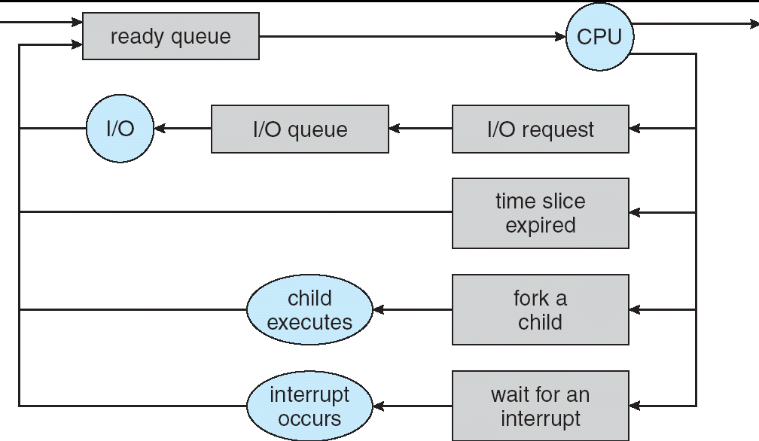
Recall: CPU Scheduling
Earlier, we talked about the life-cycle of a thread
Active threads work their way from Ready queue to Running to various waiting queues.

Slide 82
Recall: CPU Scheduling (Cont.)
Question: How does OS decide which thread to dequeue?
Obvious queue to worry about is ready queue
Others can be scheduled as well, however
Scheduling: deciding which threads are given access to resources from moment to moment

Slide 83
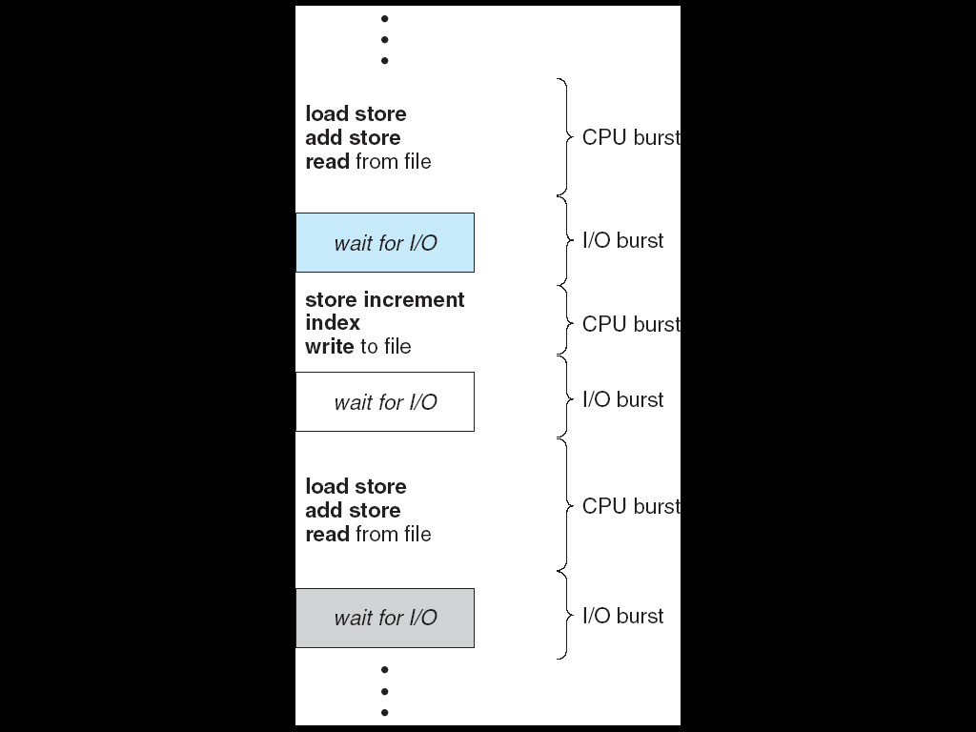
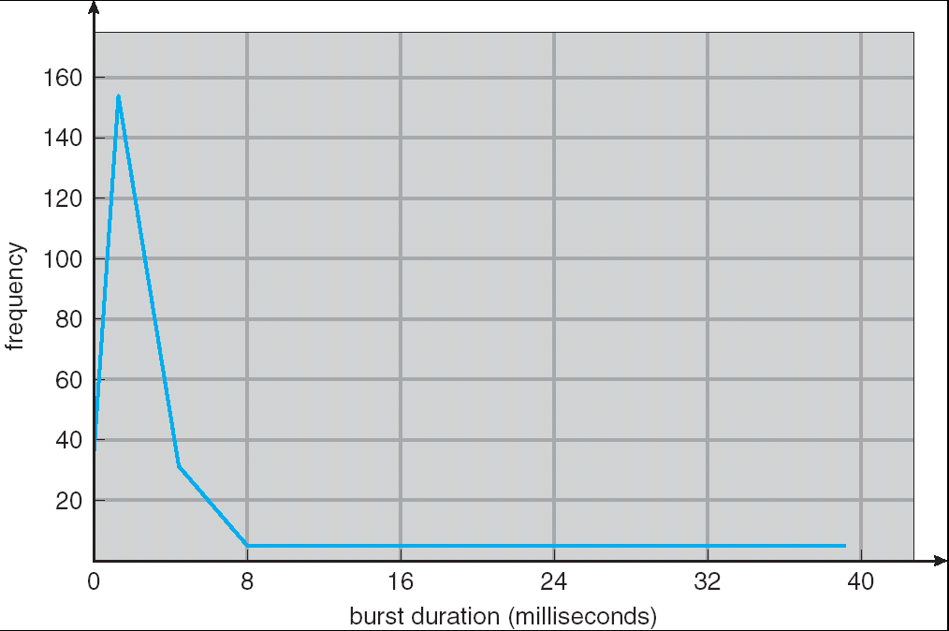
Assumption – CPU Bursts
Weighted toward small bursts
Execution model: programs alternate between bursts of CPU and I/O
Program typically uses the CPU for some period of time, then does I/O, then uses CPU again
Each scheduling decision is about which job to give to the CPU for use by its next CPU burst
With timeslicing, thread may be forced to give up CPU before finishing current CPU burst

Slide 84
Scheduling Assumptions
CPU scheduling big area of research in early 70’s
Many implicit assumptions for CPU scheduling:
One program per user
One thread per program
Programs are independent

Slide 85
Scheduling Assumptions (Cont.)
Clearly, unrealistic but they simplify the problem
For instance: is “fair” about fairness among users or programs?
If I run one compilation job and you run five, you get five times as much CPU on many operating systems
The high-level goal: Dole out CPU time to optimize some desired parameters of system
USER1
USER2
USER3
USER1
USER2
Time

Slide 86
Synchronization Summary
Monitors: A lock plus zero or more condition variables
Always acquire lock before accessing shared data
Use condition variables to wait inside critical section
Three Operations: Wait(), Signal(), Broadcast()

